Slide 1
E-Book Application System Integration (E.A.S.I.)
Seraphim

Slide 2
Clients
Our Clients:
Ms. J’aimé Pfeiffer (Capital Region BOCES)
Ms. Jen Cannell (Questar III)
Guests
Dr. Meg Fryling
Dr. Darren Lim

Slide 3
Introductions
Daniel Street: Team Leader
Lauren Mathews : Web Master
Nicholas Roth: Database Manager
Kevin Mango: Development Director
Tyler Carpenter-Rivers: Document Analyst

Slide 4
Problem Overview
Seraphim’s clients, Ms. Jen Cannell and Ms. Jaimé Pfeiffer, are in need of a single sign-on system for students to access e-books from their district’s libraries.

Slide 5
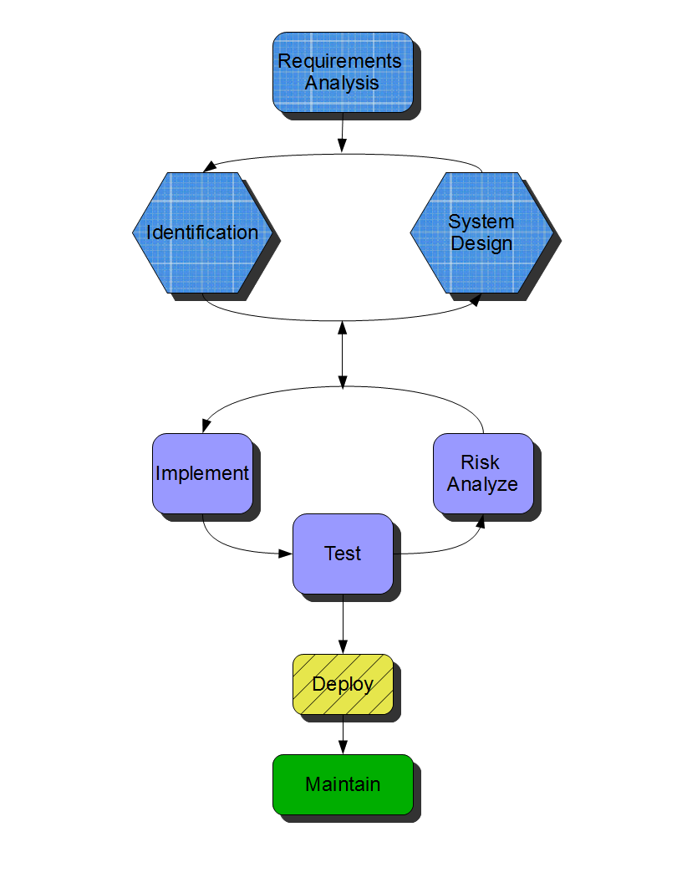
Spiralfall

Slide 6
Functional Requirements
All users can log-in, log-out
All users can gain access to e-books
All users can search e-books
Teachers can edit student information
Administrators can edit vendor information
Administrators can edit all user types
Administrators can edit e-books information

Slide 7
Non-Functional Requirements
Responsive (respond reasonably to queries)
Scalable (for large amounts of data)
Secure (data, especially authentication)
Viewable (on multiple platforms)
Intuitive (for all users)
Maintenance (by administrators)

Slide 8
Testing Plan
Unit Testing: Each function tested separately
Integration Testing: Tested between units
System Testing: Satisfies Requirements Inventory
Performance Testing: Stress Testing System
Acceptance Testing: Final Product

Slide 9
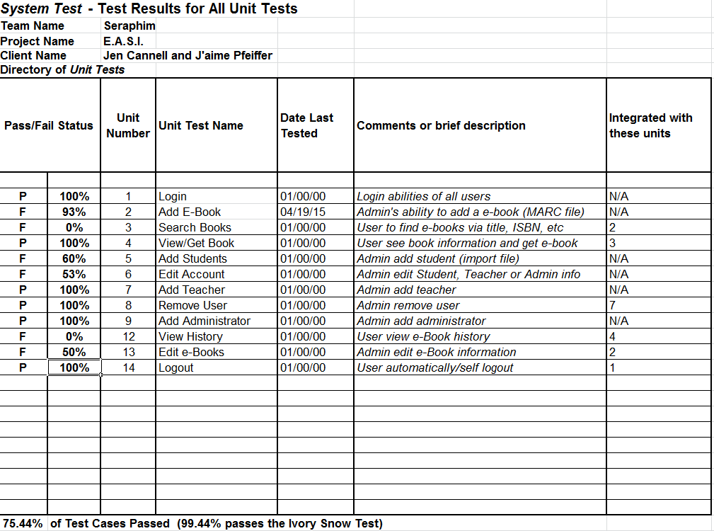
Unit Tests - Directory

Slide 10
E.A.S.I. Prototype

Slide 11
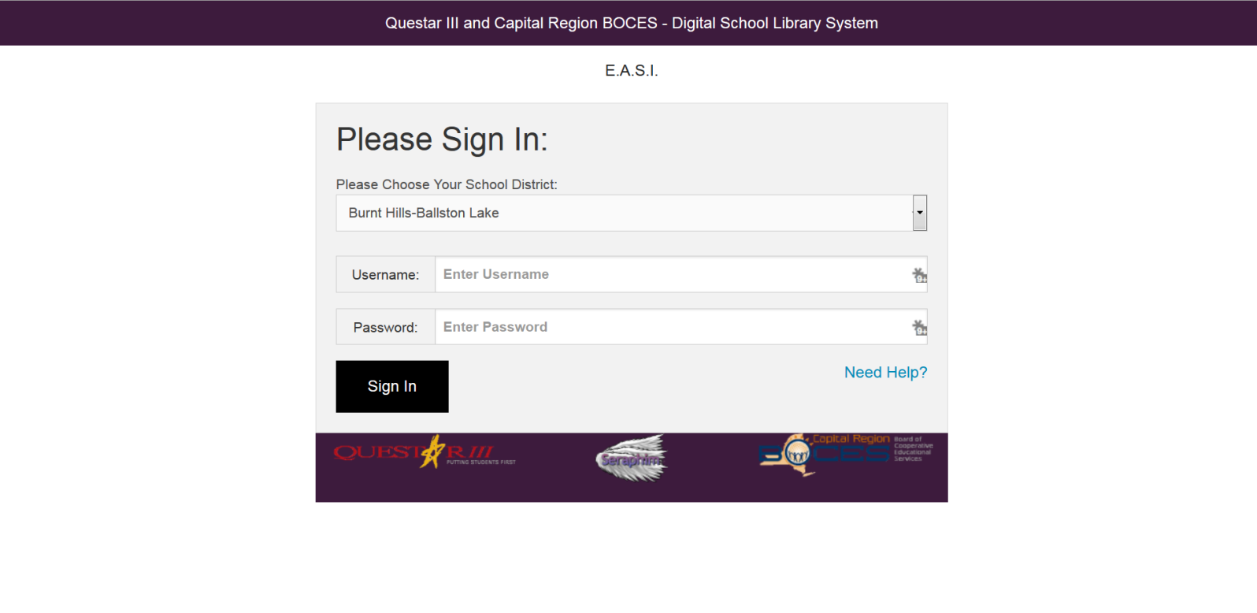

Slide 12
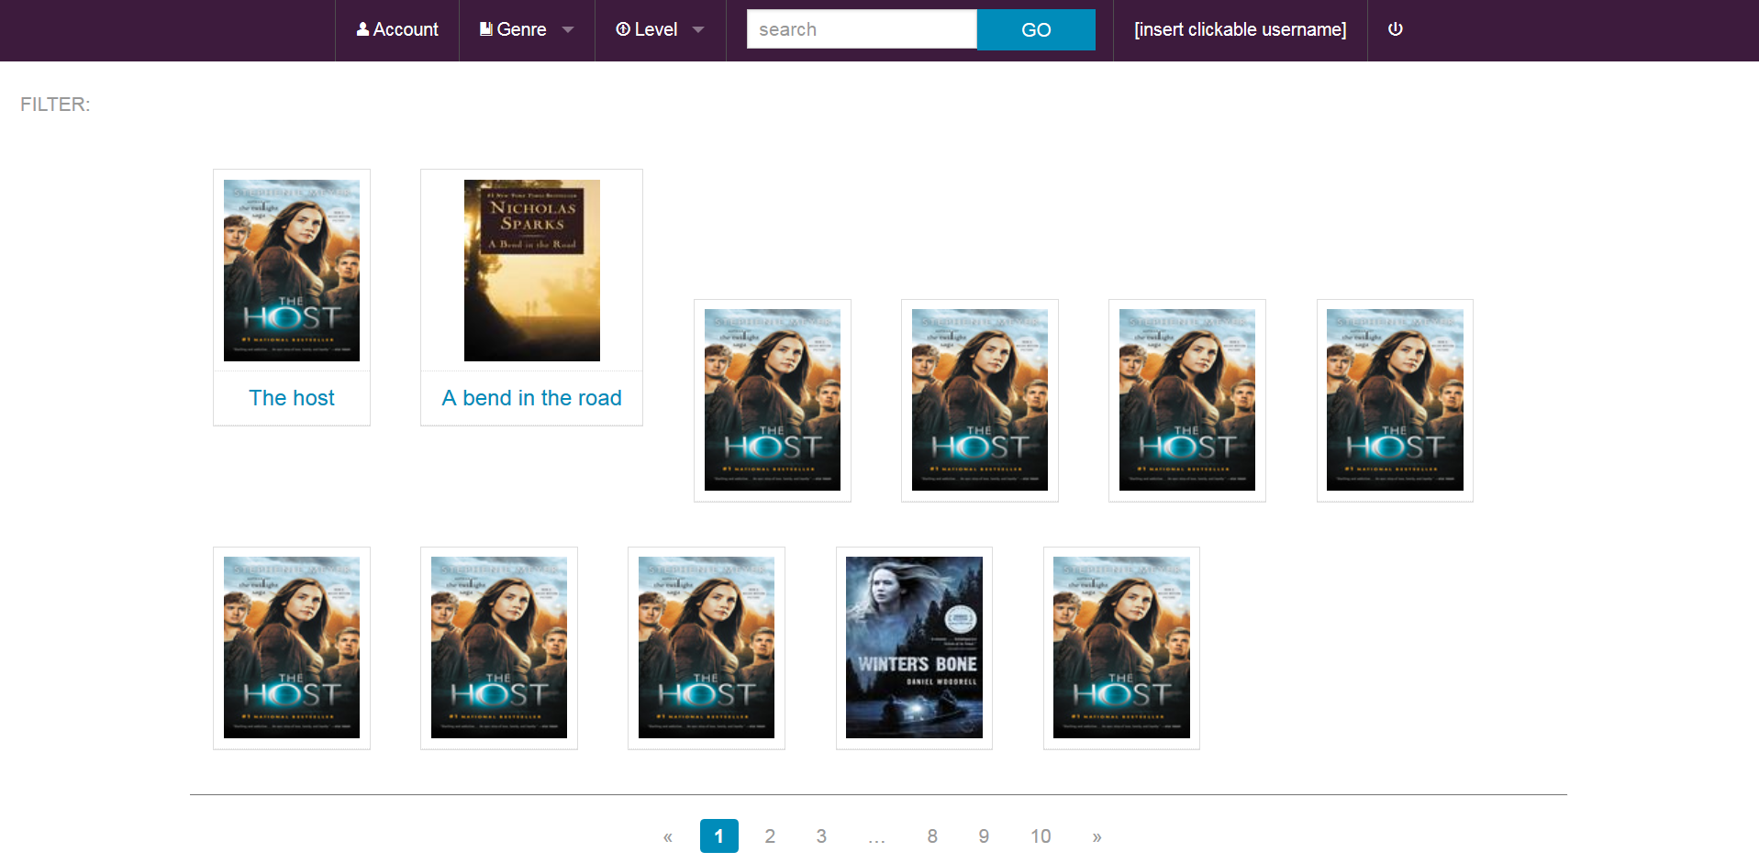

Slide 13
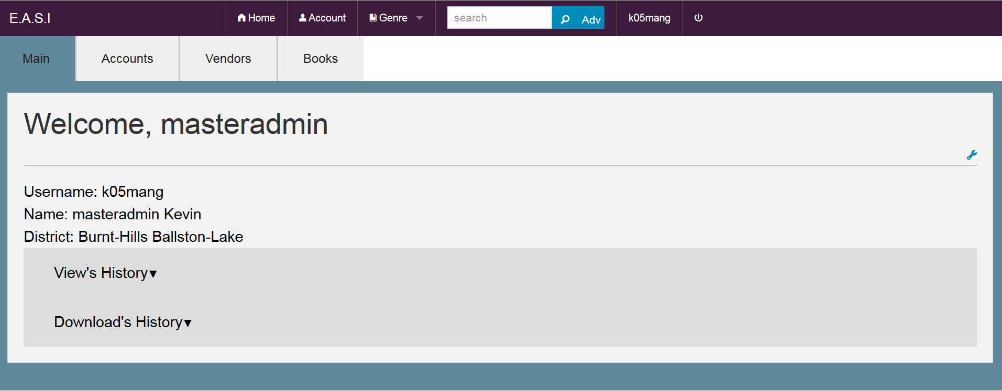

Slide 14
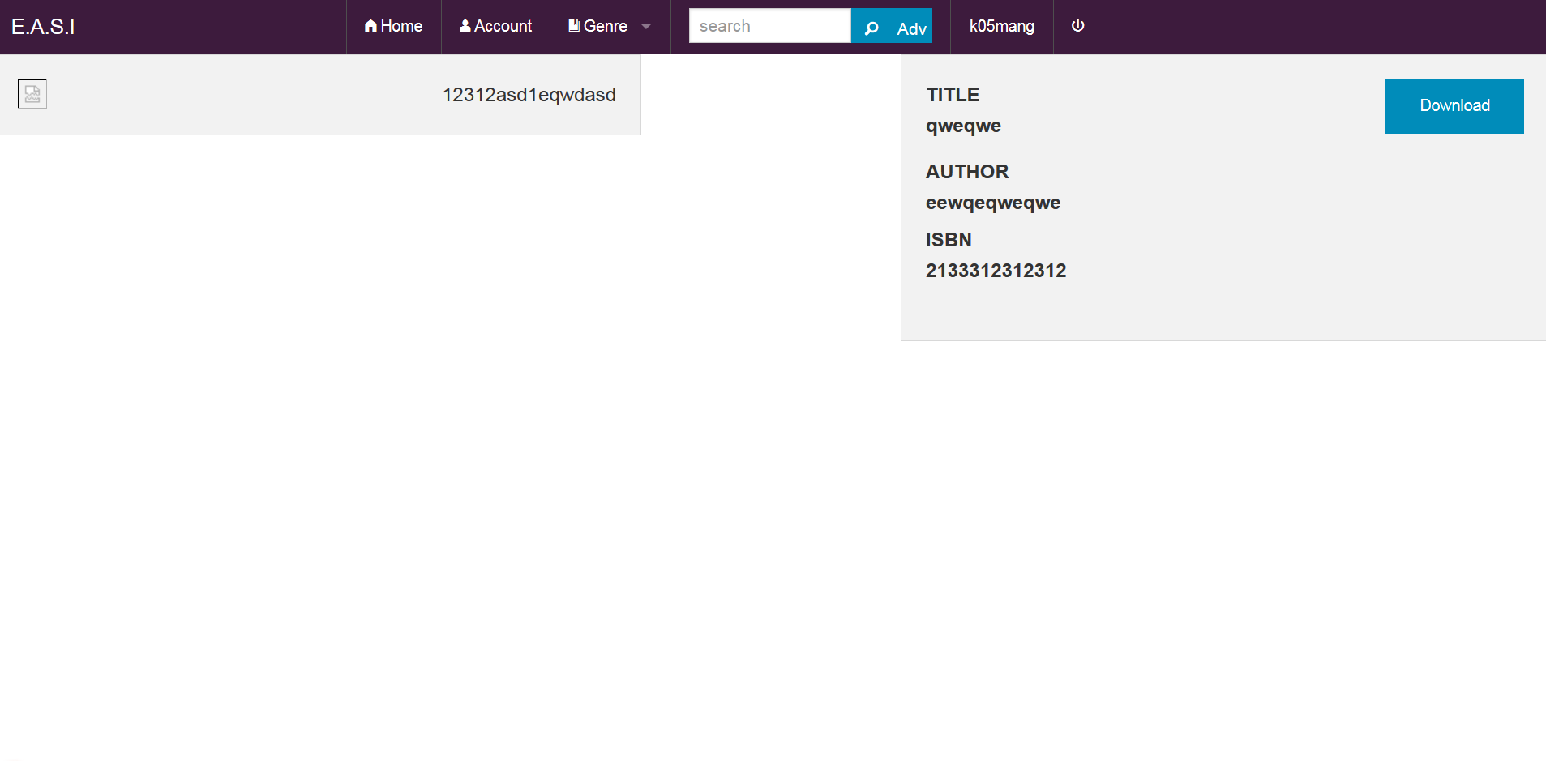

Slide 15
Deliverables
Project Files
Website Files
Team Video
Documentation

Slide 16
Timeline

Slide 17
What’s Next?
Team Song
Academic Celebration (4/24/15)
Software Party!
Graduation
Kill the Dragon!!!

Slide 18
Questions?

Slide 19
Agenda
System Definition
Problem Overview
Project Plan
Functional & Non-Functional Requirements
Life Cycle
Introductions
Deliverables
Testing Plan
Unit Tests
What’s Next

